Slide 1
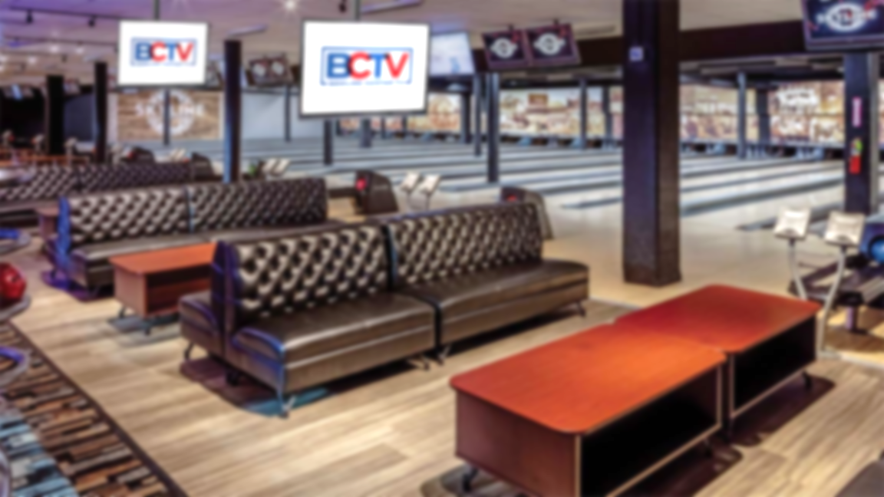




Think outside the frame.

Slide 2



Introducing BCTV
BCTV is a national television network deployed across bowling centers throughout the U.S.
In-center deployment of BCTV screens enhances the consumer experience
Curated programming schedule, updated daily
Unique on-premise audience dynamic for deep brand engagement:
    Almost 2-hour average visit
    Extensive ”dwell-time”
    Consumer is in a good mood
BCTV offers brands two levels of advertising:
  Nationally across the entire BCTV network
  Locally within specific BCTV bowling centers
-
4

Slide 3
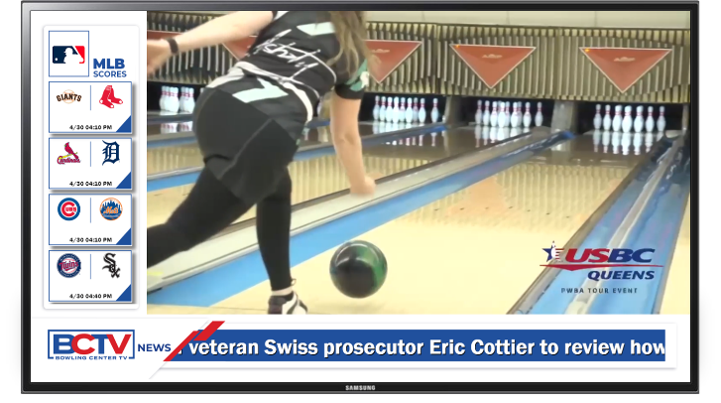
Introducing BCTV
BCTV is a national television network deployed across bowling centers throughout the U.S.
In-center deployment of BCTV screens enhances the consumer experience
Curated programming schedule, updated daily
Unique on-premise audience dynamic for deep brand engagement:
    Almost 2-hour average visit
    Extensive ”dwell-time”
    Consumer is in a good mood
BCTV offers brands two levels of advertising:
  Nationally across the entire BCTV network
  Locally within specific BCTV bowling centers
-
4

Slide 4
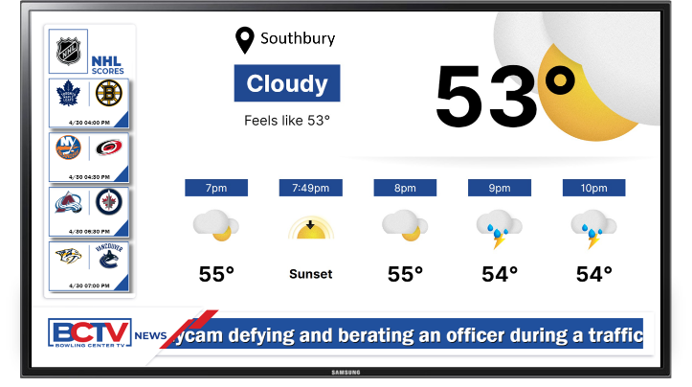
Introducing BCTV
BCTV is a national television network deployed across bowling centers throughout the U.S.
In-center deployment of BCTV screens enhances the consumer experience
Curated programming schedule, updated daily
Unique on-premise audience dynamic for deep brand engagement:
    Almost 2-hour average visit
    Extensive ”dwell-time”
    Consumer is in a good mood
BCTV offers brands two levels of advertising:
  Nationally across the entire BCTV network
  Locally within specific BCTV bowling centers
-
4

Slide 5







BCTV Curated Content
Sports highlights
News alerts
Entertainment spotlights
Plus:
Trivia Questions & Contests
Featured accomplishments
Birthdays and other celebrations
Record setting scores; ”300” games

Slide 6
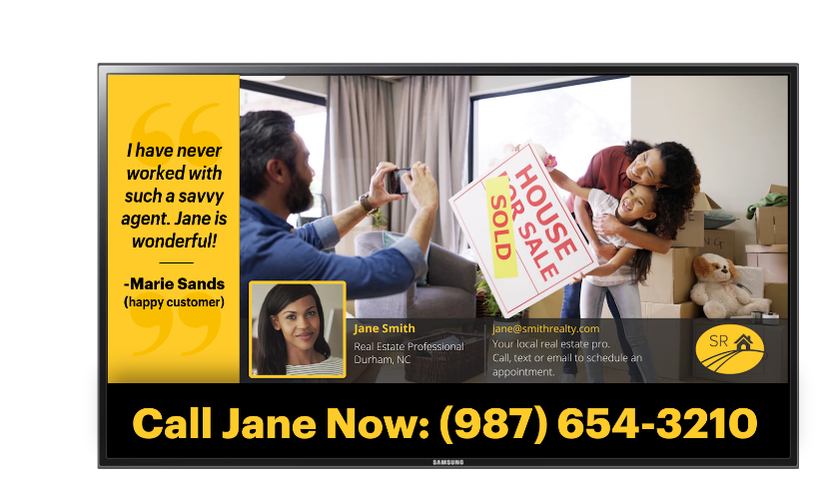
Local Advertising Opportunity
The Opportunity
Local businesses can now advertise on BCTV
Ad schedules are based on {YOUR CENTER NAME’S} operation
  Benefit from {YOUR CENTER’S NAME} unique offering:
  A community hub
  Large-scale foot traffic/audience
  Showcase your brand in a TV experience
  Benefit from being surrounded by blue-chip national brand advertisers
  Harness the loyalty of repeat visitors
  Close proximity to your business
  Customers that are loyal to:
    {YOUR CENTER NAME HERE}
    Local businesses that support us!

Slide 7
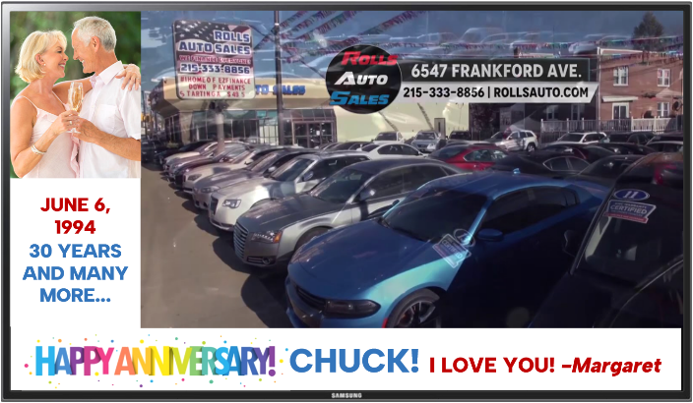
On-Screen Ad Positions
Vertical L-Bar Position
Embedded Video or Static Ad Unit
3 Available ad units/types:
Video Commercial Unit
Static Display Unit
L-Bar Display Unit
NOTES:
Brands have the option to leverage one, two, or all three ad units/types.
The vertical and horizontal L-Bar positions are combined into a single ad unit.
Horizontal L-Bar Position

Slide 8
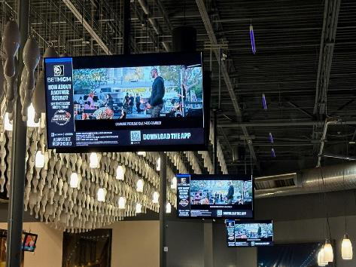
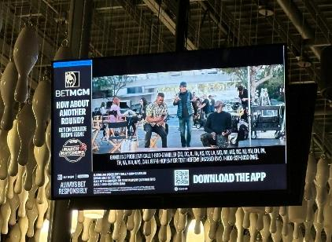
BCTV Screen Footprint
{CENTER NAME} Fast Facts
List # of screens installed
List hours of operation
List center‘s address
Proof of Performance
Advertiser shall receive a group of proof-of-performance recap reports upon conclusion of ad buy. The reports shall include the dates/times indicating when all video/L-bar ad units have aired, audience impression counts and photos of your ad creative on our BCTV screens.

Slide 9

Advertising Packages
BCTV offers local business advertising packages that deliver a fixed amount of inventory each day at your center. Businesses can choose from three sales package options. Pricing below is based upon an average-sized center and market. Pricing can vary.
Option #1
1x 30 second video ad unit per hour (Primary Video Portion of Screen)
  • $400 per Month for Video Portion of Screen Only
  • $480 per Month for Video Portion of Screen Plus L-Bar (Full-Screen Takeover!)
Option #2
2x 30 Second Video Ad Units per Hour (Primary Video Portion of Screen)
  • $750 per Month for Video Portion of Screen Only
  • $900 per Month for Video Portion of Screen Plus L-Bar (Full-Screen Takeover!)
Option #3
4x 30 second video ad units per hour (Primary Video Portion of Screen)
• $1,250 per Month for Video Portion of Screen Only
• $1,500 per Month for Video Portion of Screen Plus L-Bar (Full-Screen Takeover!)

Slide 10
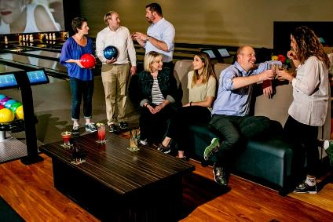
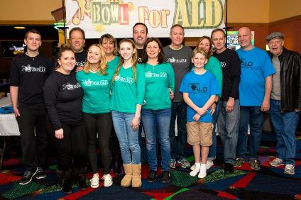
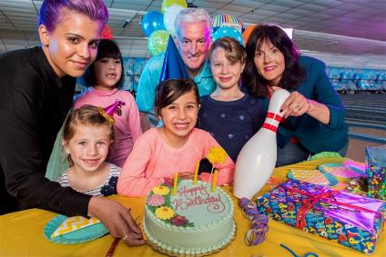
Advertising Extensions
Corporate Events
Charitable Fundraisers
Advertising extensions can be created for your events across BCTV
Birthday Parties

Slide 11
{CENTER NAME} BCTV Proposal
1x :30 Second Units Per Day | Totals
# :30 second video units per hour (per screen) | 1
Average hours of operation per day (per screen) | 11
Total :30 second video units per day (per screen) | 11
# of BCTV screens in center | 12
Total :30 second video units per day (all screens) | 132
Cost per :30 second video unit (per screen) | $0.12
Total cost per day (1 screen) | $1.44
Total cost per day (all screens) | $17.28
# of days in month | 31
Total cost per month | $535.68
L-bar ad unit (20% additional) | $107.14
Total cost per month | $642.82
# of months | 1
Total ad commitment | $642.82
Proposal Overview:
Option #1
1x 30’s per-hour share of voice
Inclusion of L-Bar ad unit
One-Month schedule
$642.00

Slide 12
{CENTER NAME} BCTV Proposal
2x :30 Second Units Per Day | Totals
# :30 second video units per hour (per screen) | 2
Average hours of operation per day (per screen) | 11
Total :30 second video units per day (per screen) | 22
# of BCTV screens in center | 12
Total :30 second video units per day (all screens) | 264
Cost per :30 second video unit (per screen) | $0.10
Total cost per day (1 screen) | $2.20
Total cost per day (all screens) | $26.40
# of days in month | 31
Total cost per month | $818.40
L-bar ad unit (20% additional) | $163.68
Total cost per month | $982.08
# of months | 1
Total ad commitment | $982.08
Proposal Overview:
Option #2
2x 30’s per-hour share of voice
Inclusion of L-Bar ad unit
One-Month schedule
$982.00

Slide 13
{CENTER NAME} BCTV Proposal
4x :30 Second Units Per Day | Totals
# :30 second video units per hour (per screen) | 4
Average hours of operation per day (per screen) | 11
Total :30 second video units per day (per screen) | 44
# of BCTV screens in center | 12
Total :30 second video units per day (all screens) | 528
Cost per :30 second video unit (per screen) | $0.09
Total cost per day (1 screen) | $3.96
Total cost per day (all screens) | $47.52
# of days in month | 31
Total cost per month | $1,473.12
L-bar ad unit (20% additional) | $294.62
Total cost per month | $1,767.74
# of months | 1
Total ad commitment | $1,767.74
Proposal Overview:
Option #3
4x 30’s per-hour share of voice
Inclusion of L-Bar ad unit
One-Month schedule
$1,767.00

Slide 14
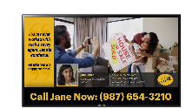
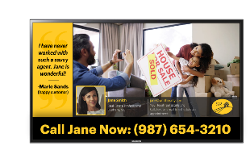
Leverage our captive audience
via BCTV to drive new revenue.

